Slide 1
Library Management System
By:
Rakesh N. Bandi - 41404
Shujath H. Talajawala - 41448
Achal S. Sawant - 41443

Slide 2
Introduction
Library management system is aimed to provide a system for the Librarian staff that can handle their daily transactions and manage the activities of library in an efficient & reliable way. It is to bring down the work load of library staff with the increased efficiency and to speed up the activities.
It keep all records of library i.e. storing details, details of availability of books, books issue details, borrowers details etc.

Slide 3
Problem Definition
Manual record keeping is not a reliable method as people tend to forget things.
For manually record keeping system a group of people have to involved in the process of managing the library and it may cost a lot & it will not be efficient for a library.
On the borrower’s point of view, in manual system borrower can’t find a book exactly at once as they are not ordered well.
Sometimes user might be searching for a book that is not available in the library in such situations people get annoyed or depressed.

Slide 4
Objectives
Develop a system that can replace the manual library managing system.
Develop a database which stores user details & book details.
Give reliable search facility for the users.
Administrator, librarian & users should have separate logins.

Slide 5
Scope
The Library Management System is an online application for assisting a librarian in managing a book library in a university.
It provides the members with online blocking of books.
It provides logon facility to the users.

Slide 6
Methodology
Study of Existing System
If one is not very careful then there is a possibility of issuing more than one book to a user.
There is a possibility of issuing a book to a user, whose membership is not there.
When a user requests for the a book, one has to physically check for the presence of a book in the library.
Answering management query is a time consuming process.
Daily keeping a manual record of changes taking place in the library such as book being issued, book being returned etc can become cumbersome.

Slide 7
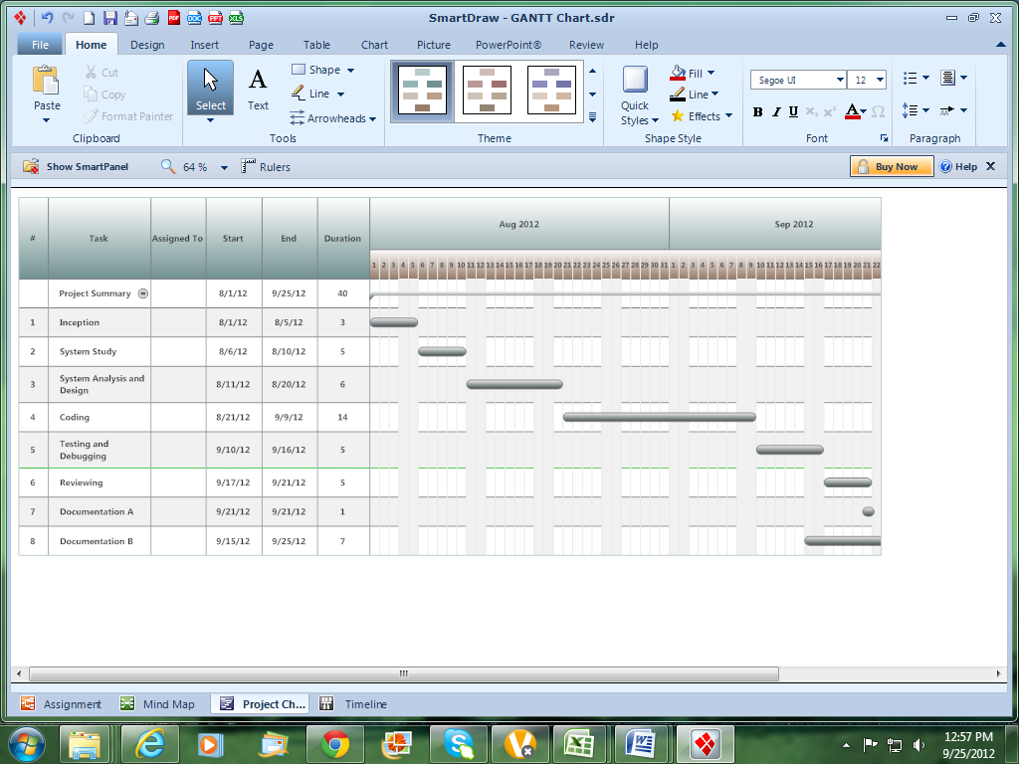
System planning
GANTT CHART

Slide 8
System Specification
Hardware Requirements:
CPU-Pentium 4 (Processor) and above, or any other equivalent.
RAM-512 MB and above
Cache Memory-512 KB
Hard Disk- 20 GB and above
Mouse/Keyboard/Printer
15.1” Screen Personal Laptop
Software Requirements :
Operating System – Windows 95/98/XP/7 with MS-office
Programming language- .NET2.0, Visual Studio 2005, 2008 or 2010
Web- Technology – ASP.NET
Back-End- SQL Server 2005 or above.
Web Server – Internet Information System (IIS)

Slide 9
Testing method
During the development or coding phase of the system, testing was being continued and system is made error free as far as possible.
For testing purpose, Unit Testing will be used.

Slide 10
Modules
Login component
Administrator (Head office manager)
Librarian
User
Administrator Component
Administrator
Librarian Manager Component
Librarian Manager
Student Component
Books Details
Issue Details

Slide 11
System development
Front-end:
Microsoft Visual Studio will be used as front-end development tool. C# is used as programming language for the system.
Back-end:
Microsoft SQL Server 2008 will be used as database backend for LMS.

Slide 12
Use case diagram

Slide 13
Sequence diagram

Slide 14
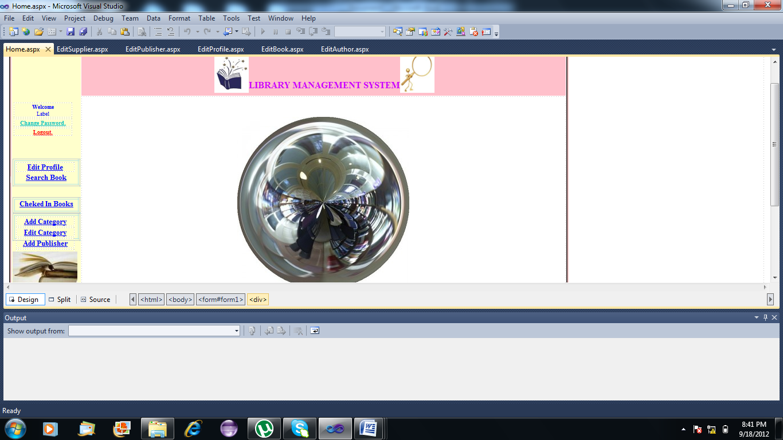
LMS Snapshots
Home page of LMS

Slide 15
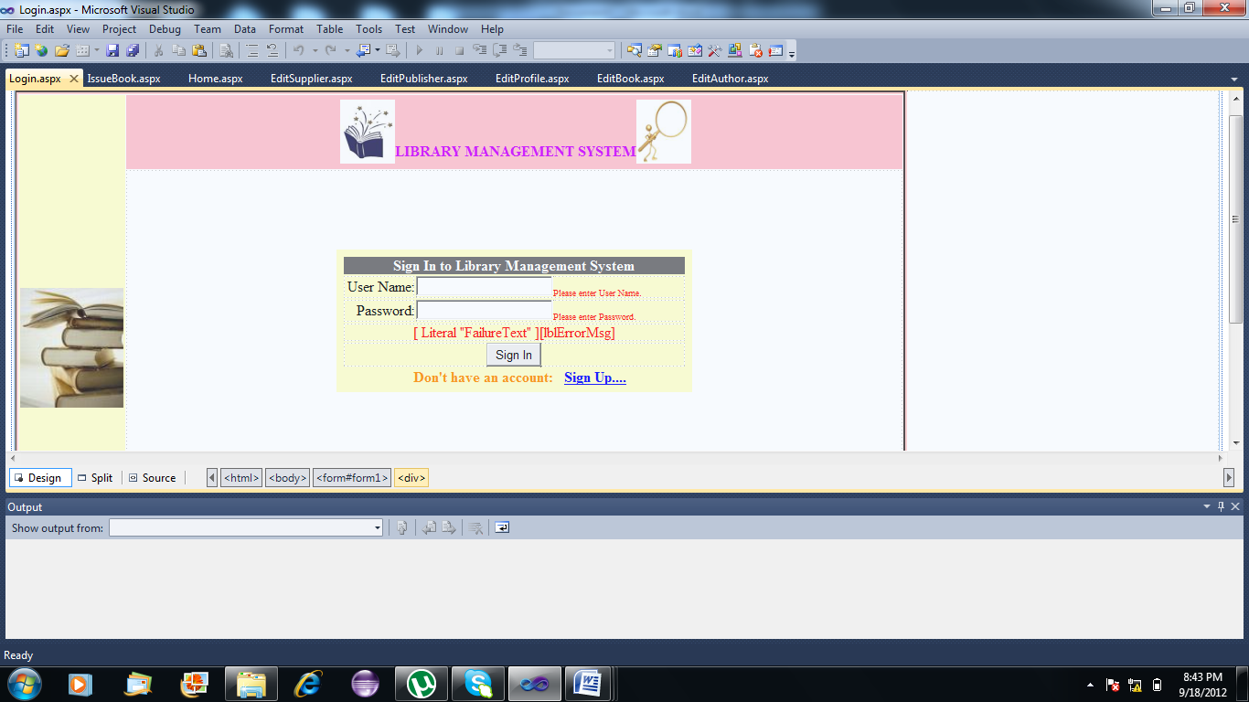
Log in

Slide 16
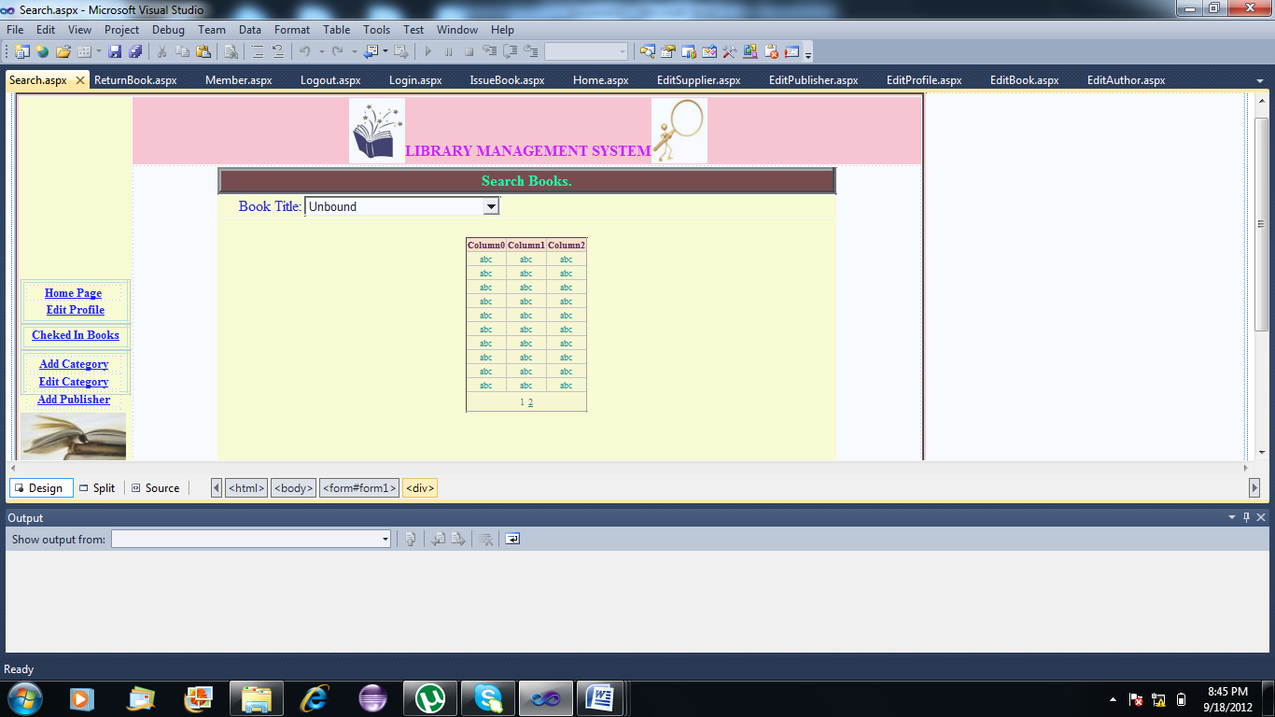
Search Book

Slide 17
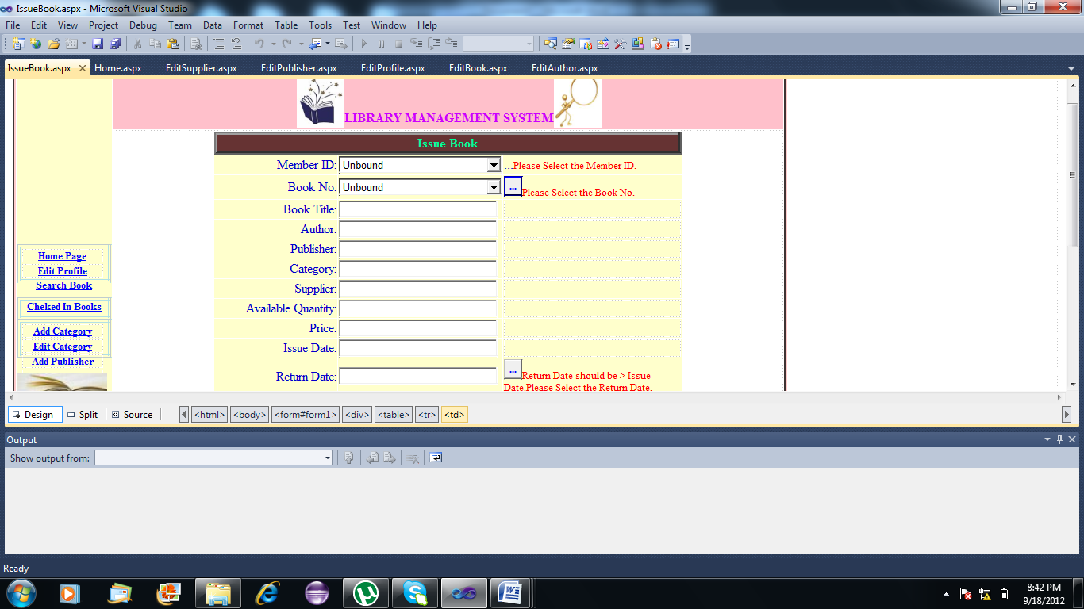
Issue Book

Slide 18
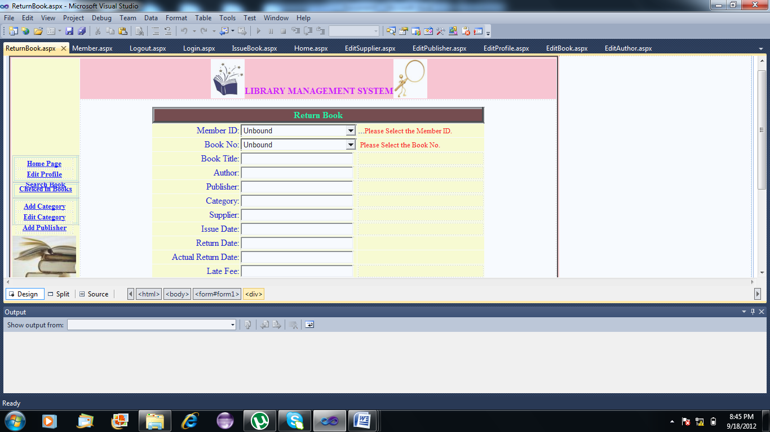
Return Book

Slide 19
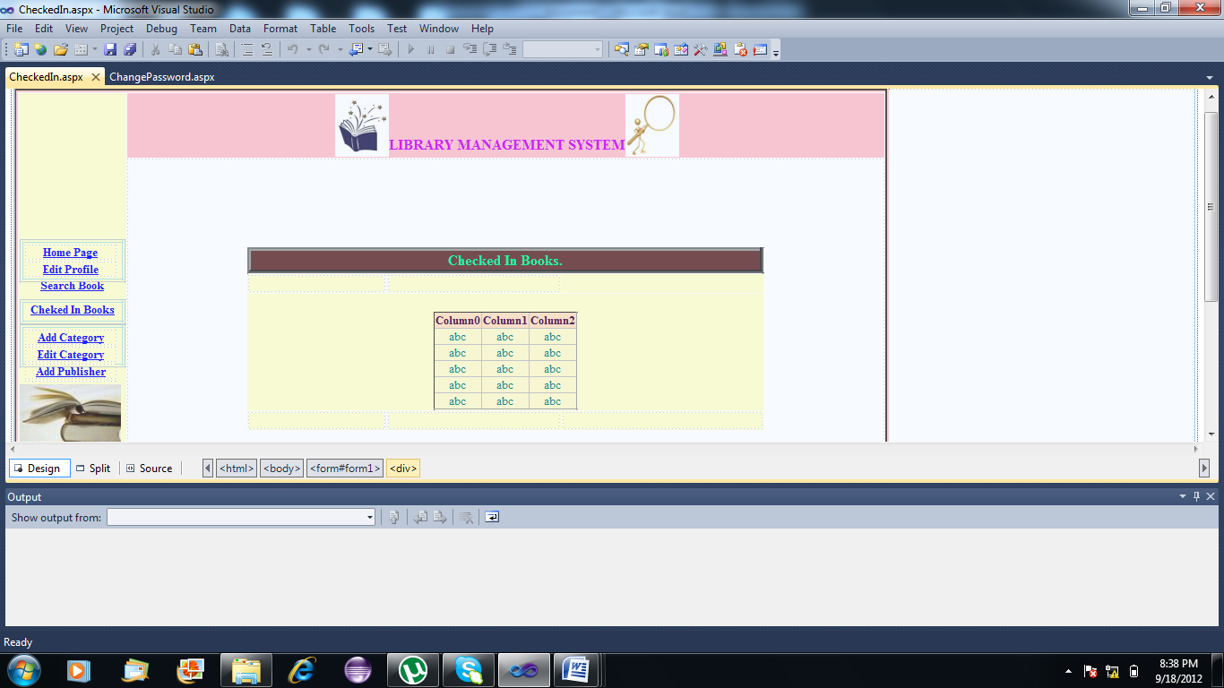
CheckedIn

Slide 20
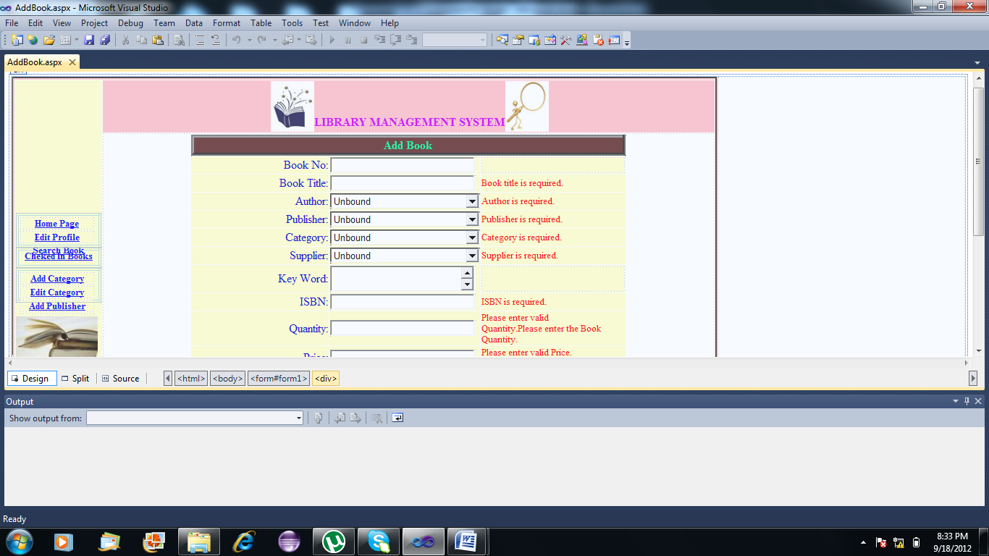
Add Book

Slide 21

Edit Book

Slide 22
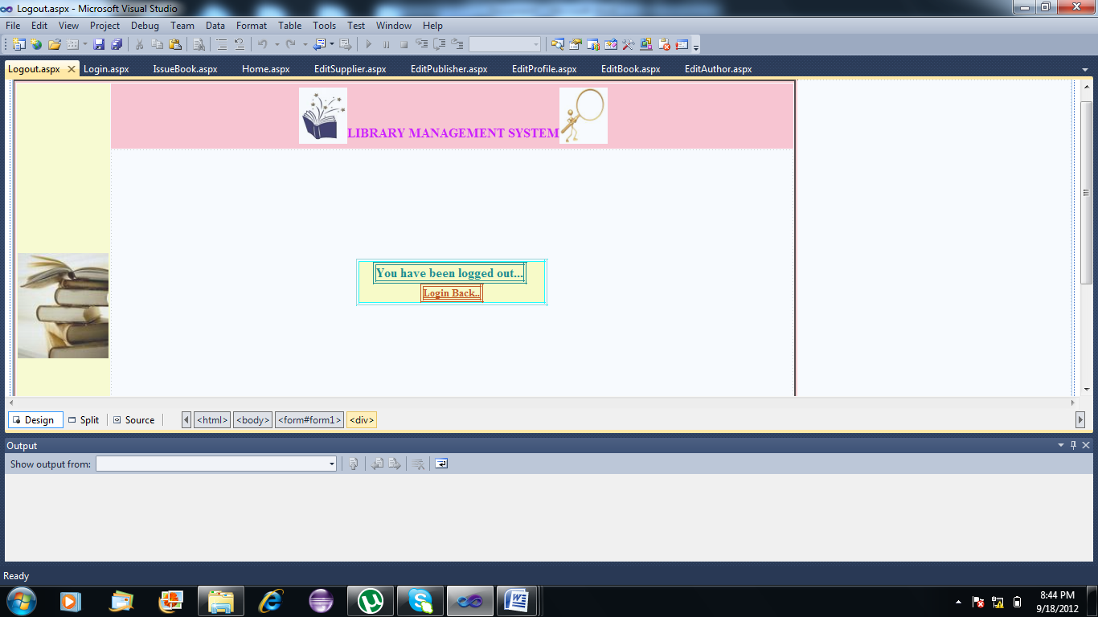
Log Out

Slide 23
Conclusion
So, this library management system will develop a system that can replace the manual work. The work load of the administrator is reduced to a great extent by computerized transactions and instant information about the books in the library. It will also provide a common platform for Administrators, Librarians and Students to communicate globally.

Slide 24
Thank You !

